Slide 1
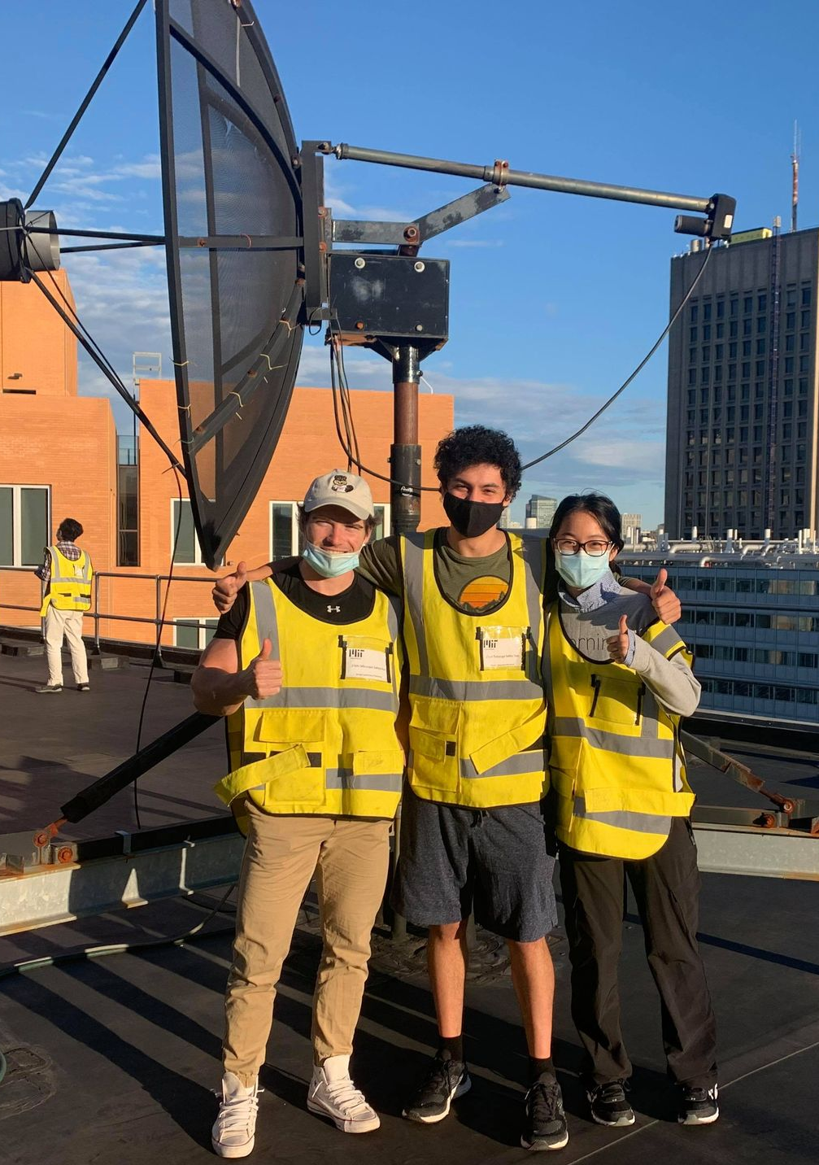
21 cm Radio Astrophysics
Octavio Vega and Luke Gianni
8.13 Experimental Physics 1 – Fall 2021

Slide 2
Experimental Goals
Derive the Rotation Curve of the Milky Way
Compare expected, Keplerian models with newer models

Slide 3
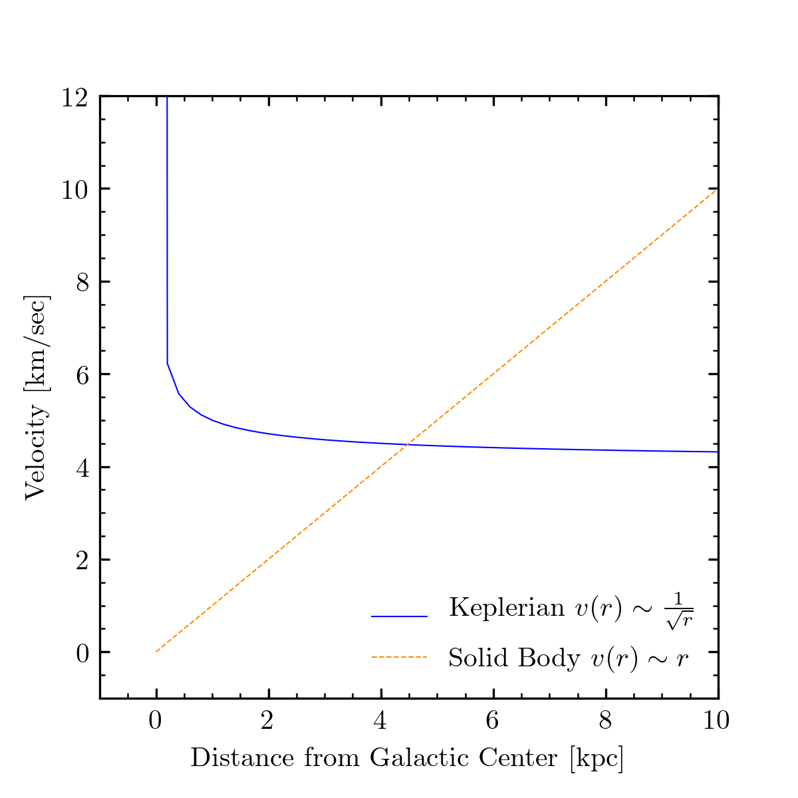
Theoretical Models of Rotation Curves

Slide 4

Theory of Gravitation and Rotation
What we know about centripetal forces:
$$\frac{mv^{2}}{r}=\frac{GmM}{r^{2}}$$

Slide 5
Apparatus Signal Chain

Slide 6
Telescope and Experiment Setup

Slide 7
Calibrating the Telescope?

Slide 8
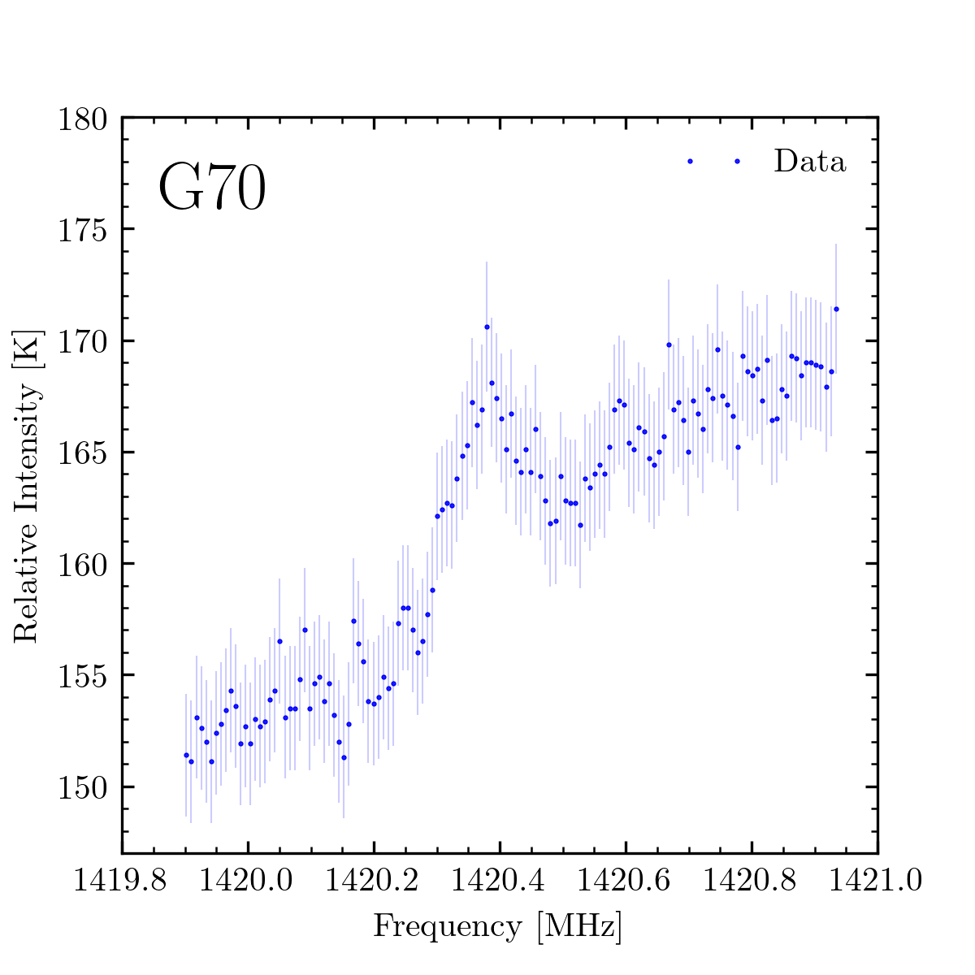
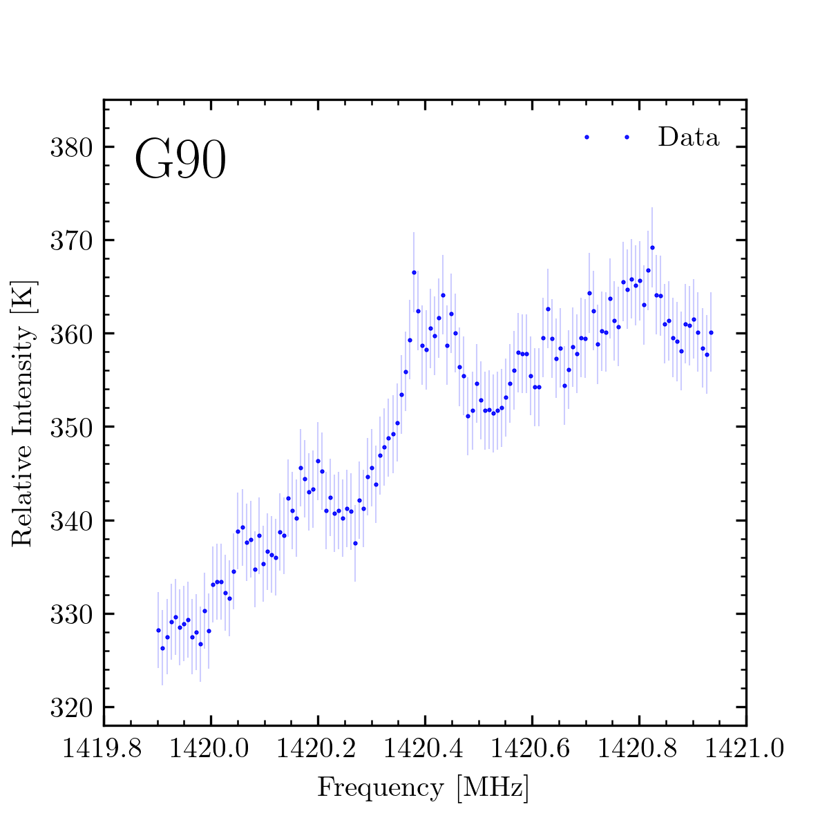
Raw Intensity Spectra in Frequency Bins

Slide 9
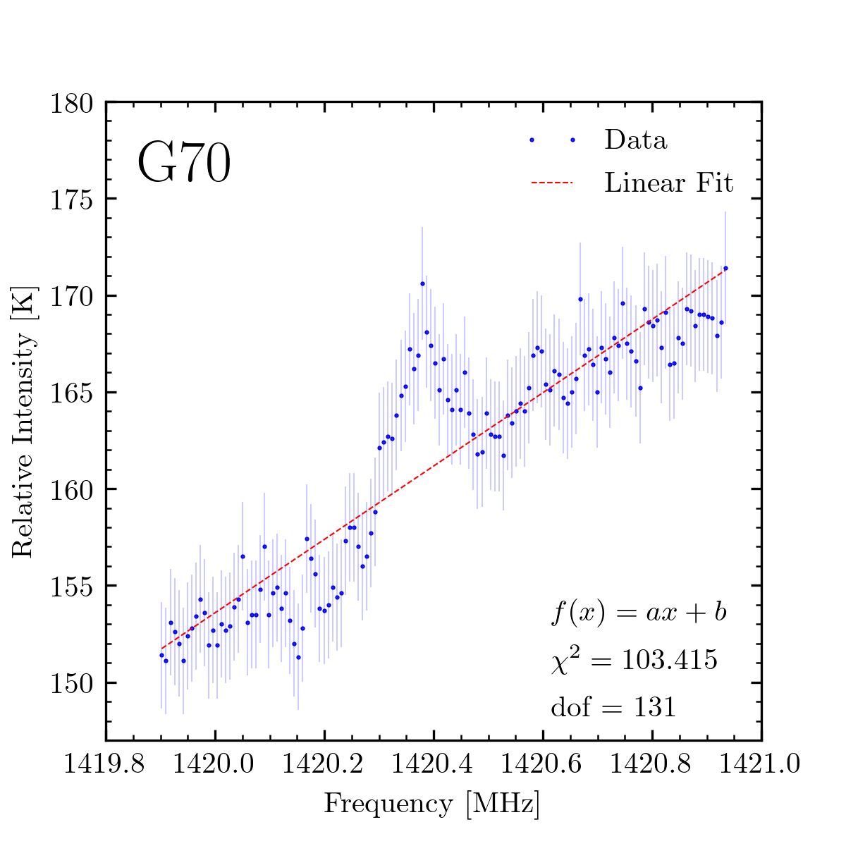
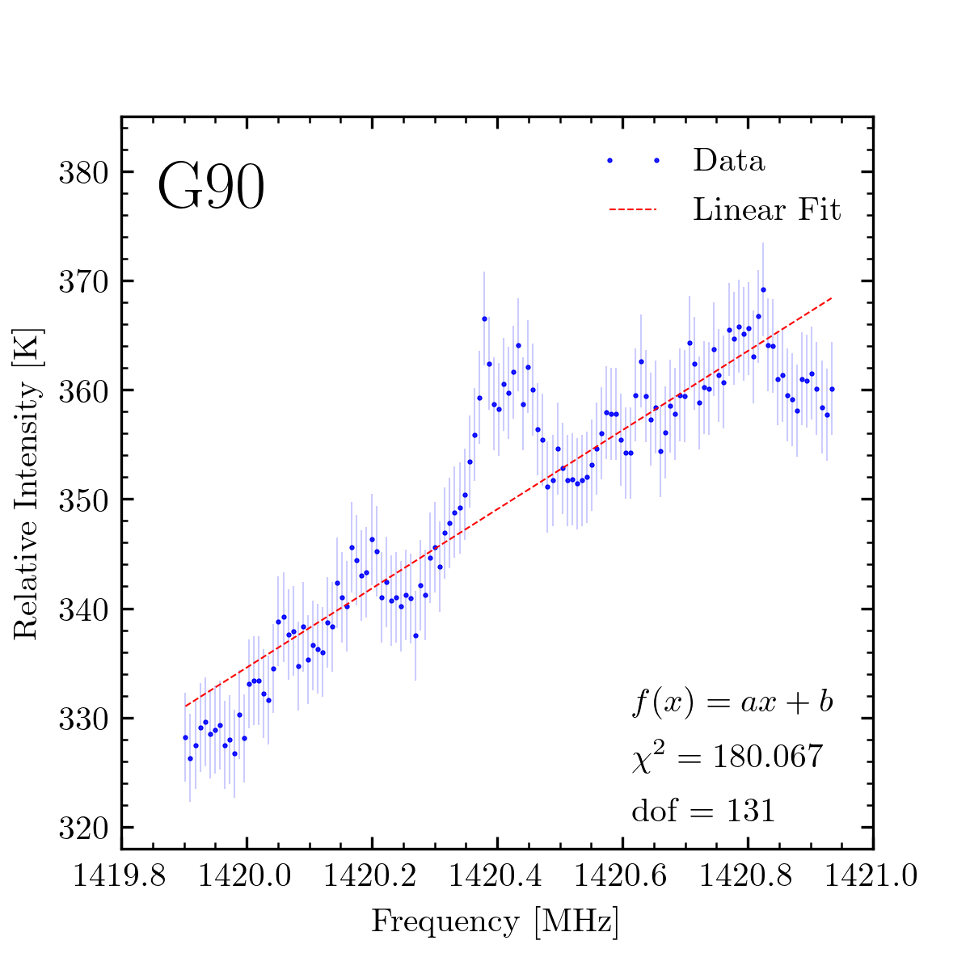
Fitting to the Background

Slide 10
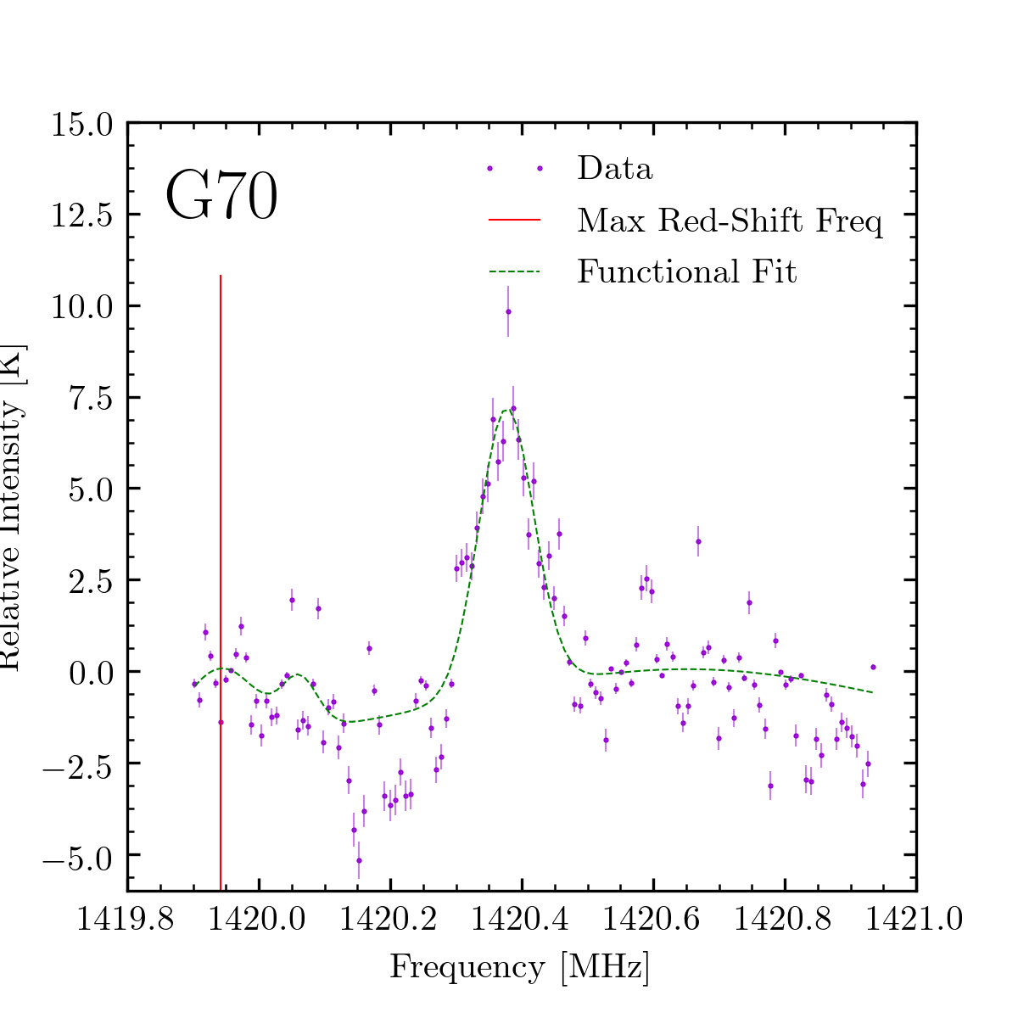
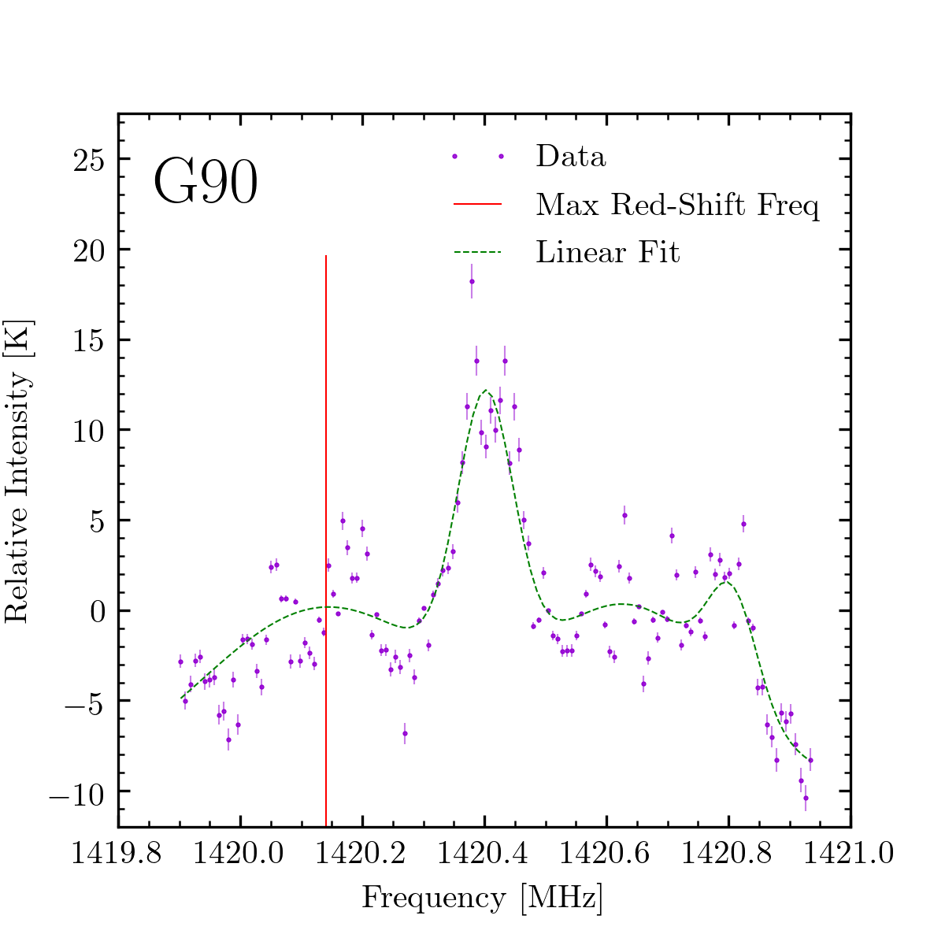
Background-Subtracted Fits to the Red Shift

Slide 11
Computing the Velocities

Slide 12
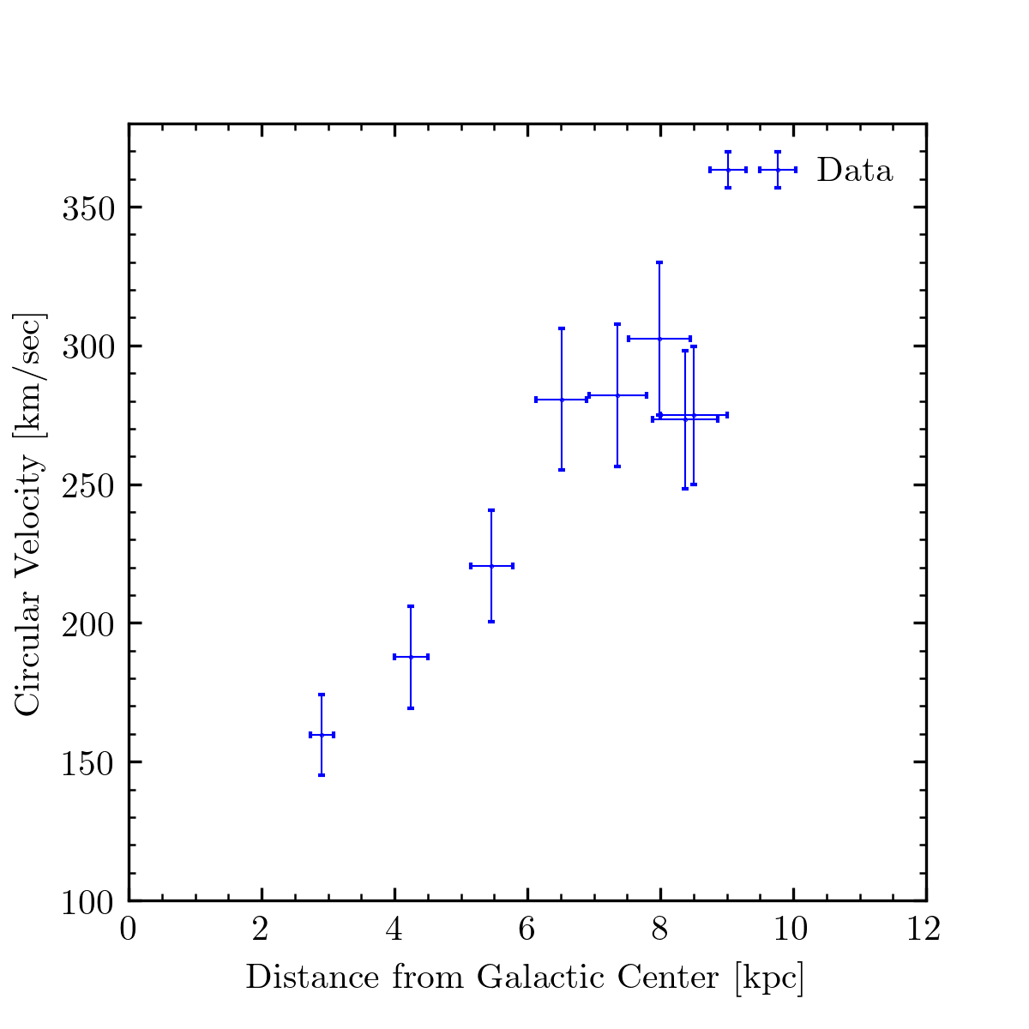
Comparing Our Rotation Curve with Other Observations

Slide 13
Fitting Velocity Data to Two Models of Rotation

Slide 14
Results and Discussion of Errors

Slide 15
Future Steps for this Analysis

Slide 16
Summary and Conclusion

